Slide 1
T1-weighted MRI

Slide 2
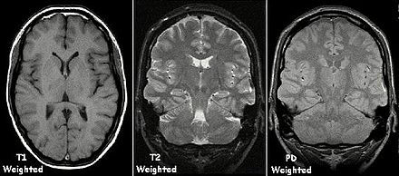
T1-weighted contrast
A
B
C
https://en.wikipedia.org/wiki/Magnetic_resonance_imaging

Slide 3
T1-weighted contrast
Source https://en.wikipedia.org/wiki/Magnetic_resonance_imaging

Slide 4
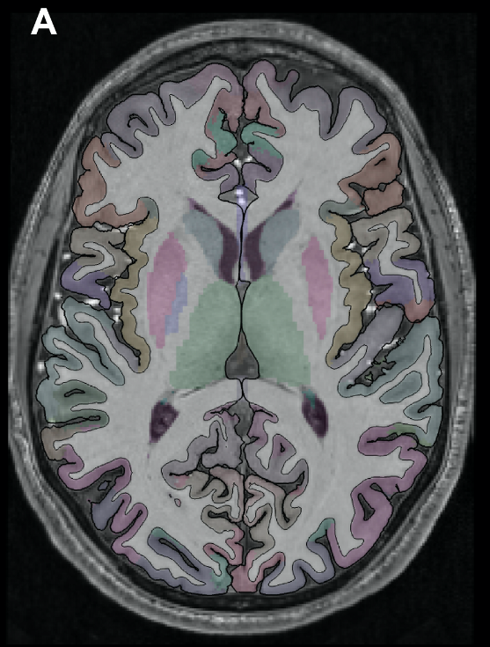
T1-weighted scans in cognitive and clinical neuroscience

Slide 5
What are they good for?

Slide 6
T1-weighted scans in cognitive and clinical neuroscience
Aging and neurodegeneration
Desease
Plasticity

Slide 7
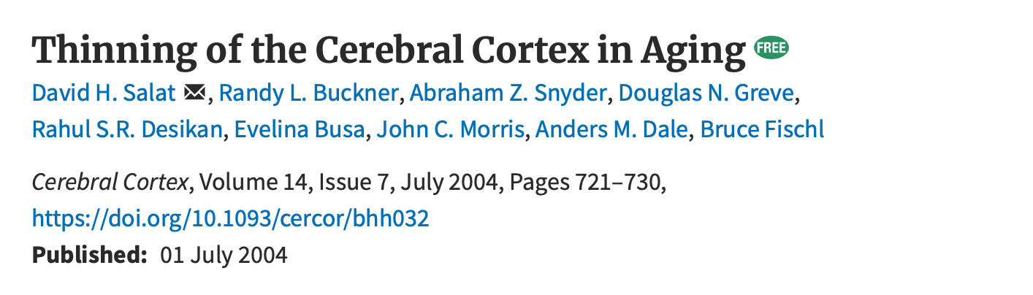
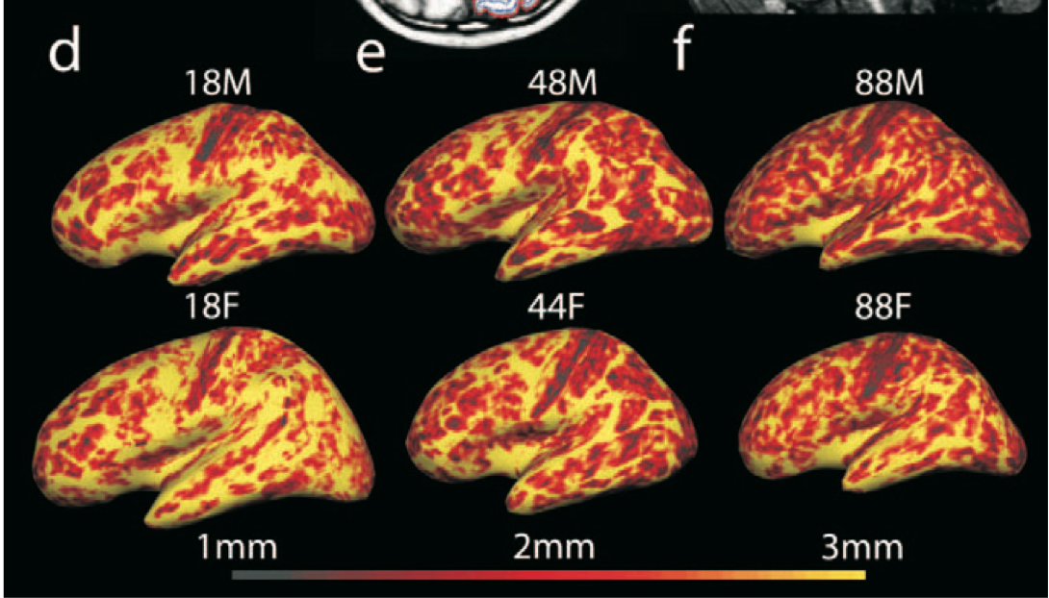

Slide 8
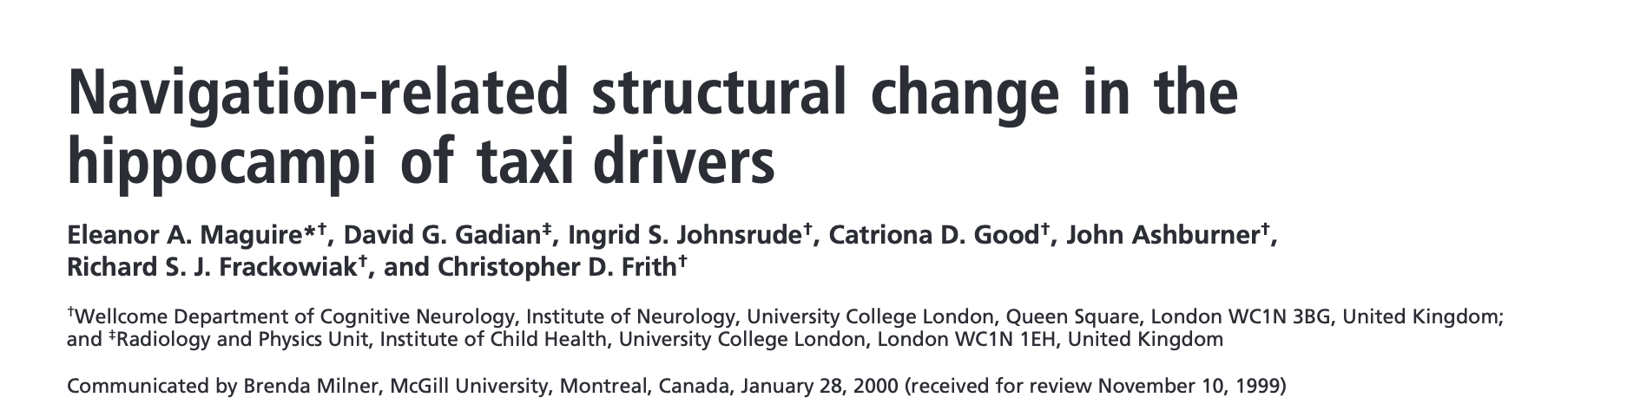
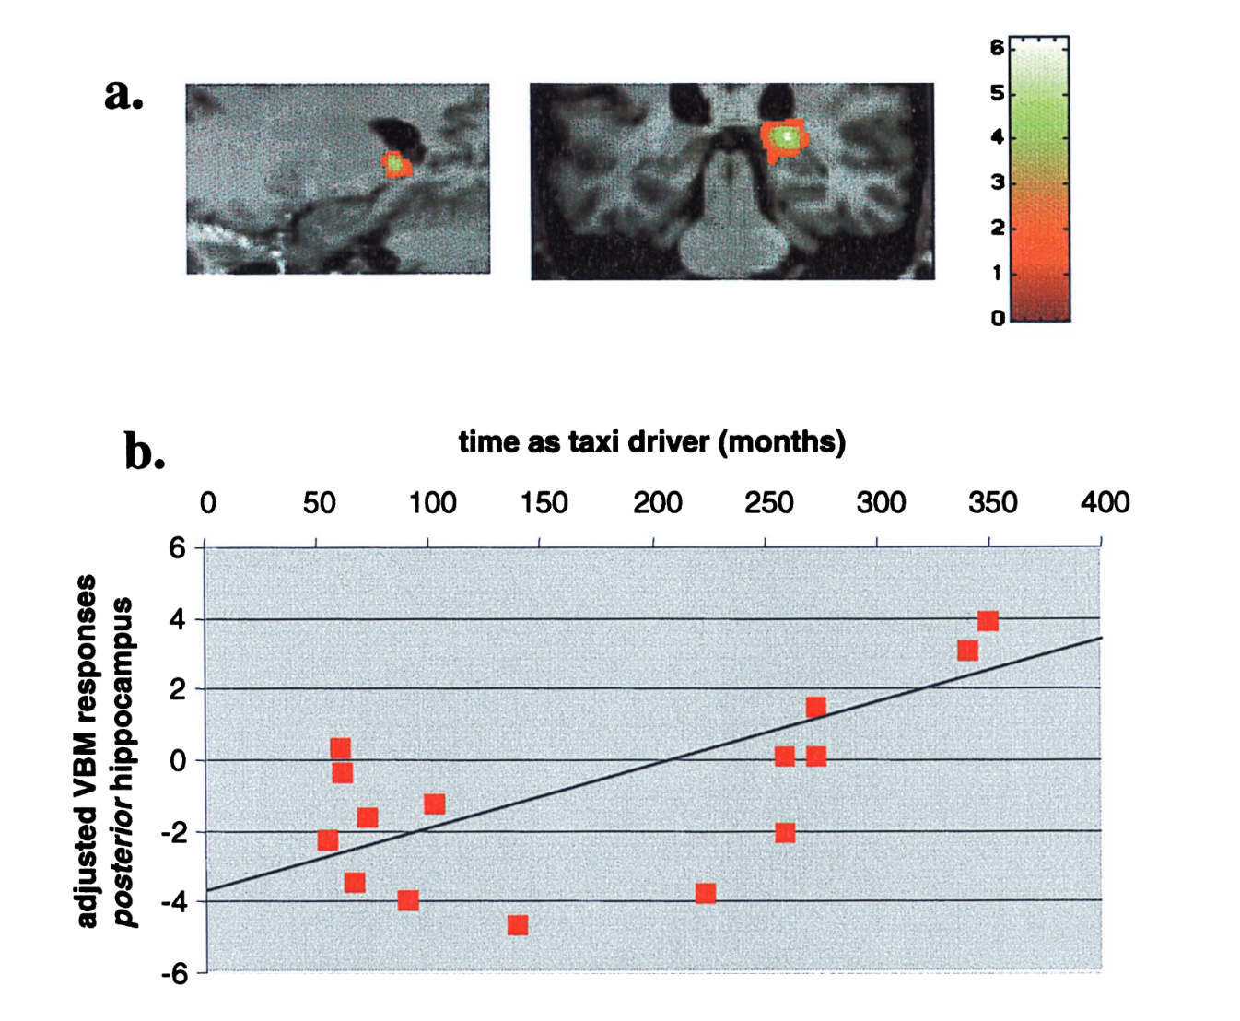

Slide 9
Typical structural T1w parameters
Gray matter density (VBM)
Cortical thickness
Volume
Surface area
Gyrification

Slide 10
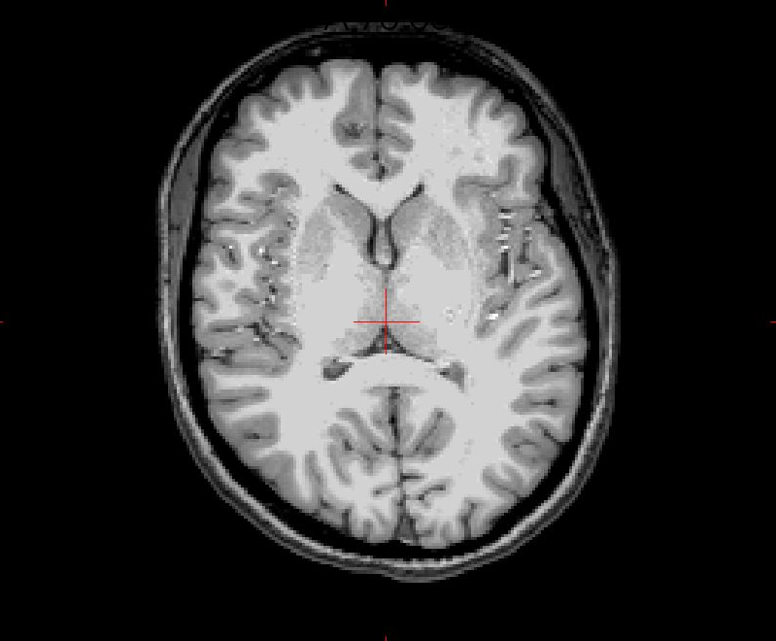
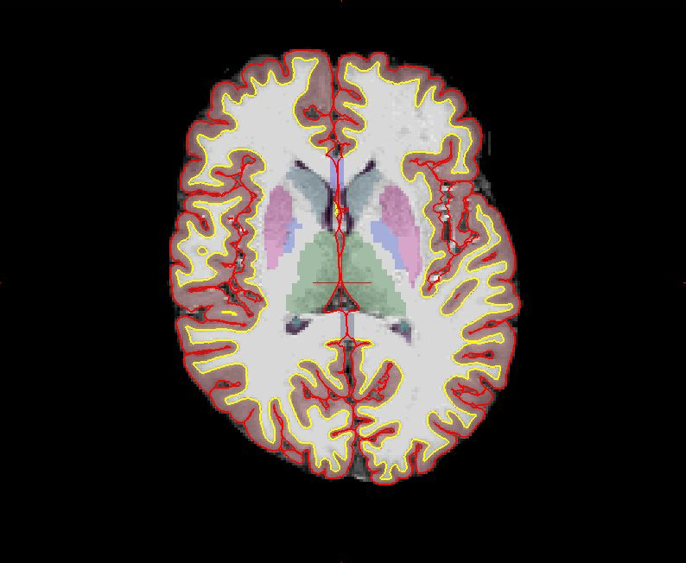

FreeSurfer recon-all
Magic
(4-6 hours)

Slide 11
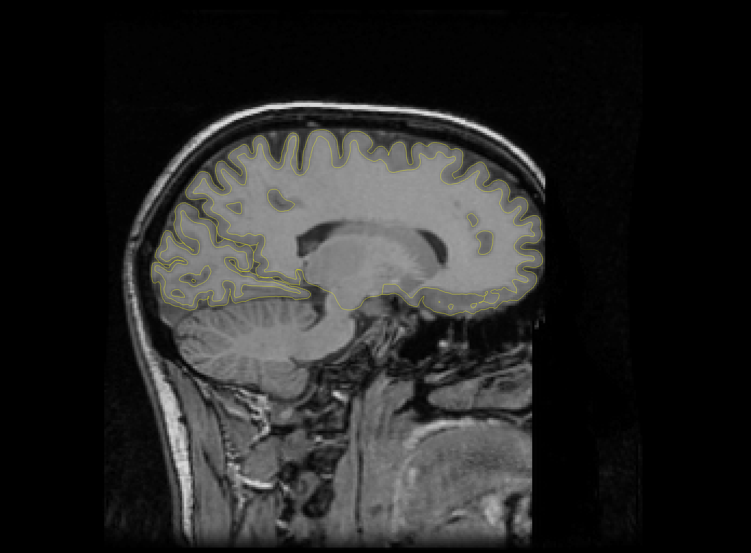
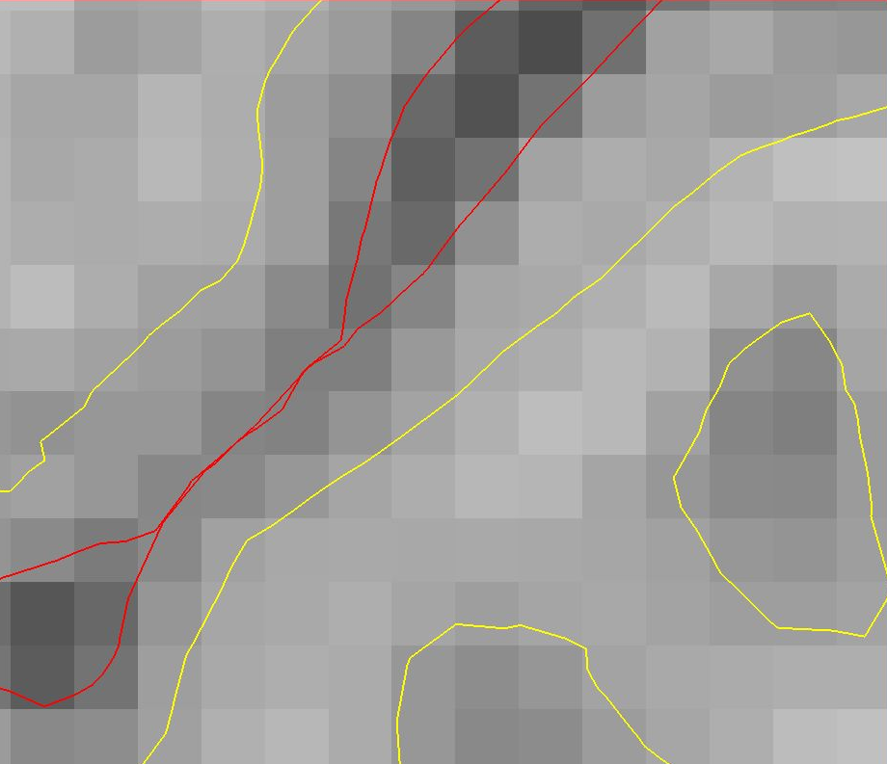
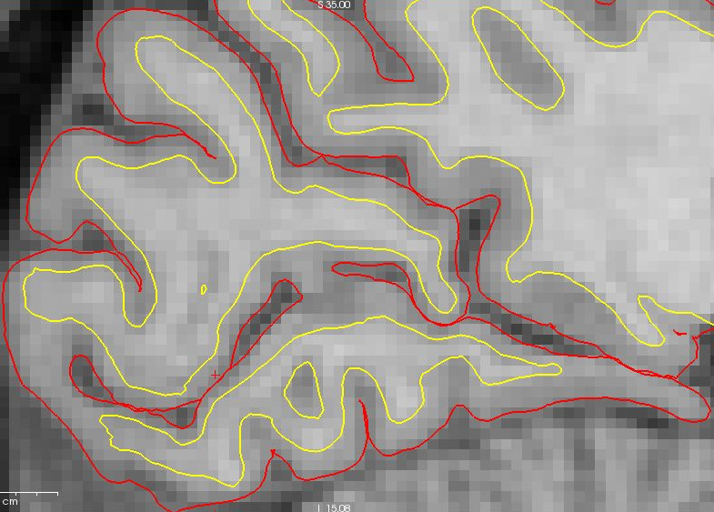
thickness
Notes:
Darum nehmen wir ein anatomisches Bild, und generieren mittels spezieller Software ein Modell der Hirnoberflaeche. Hier sieht man es in Gelb. Innen ist die Grenze zwischen der grauen und der wissen Substanz, aussen ist die Grenze zwischen der grauen Substanz und der Hirnflussigkeit.

Slide 12
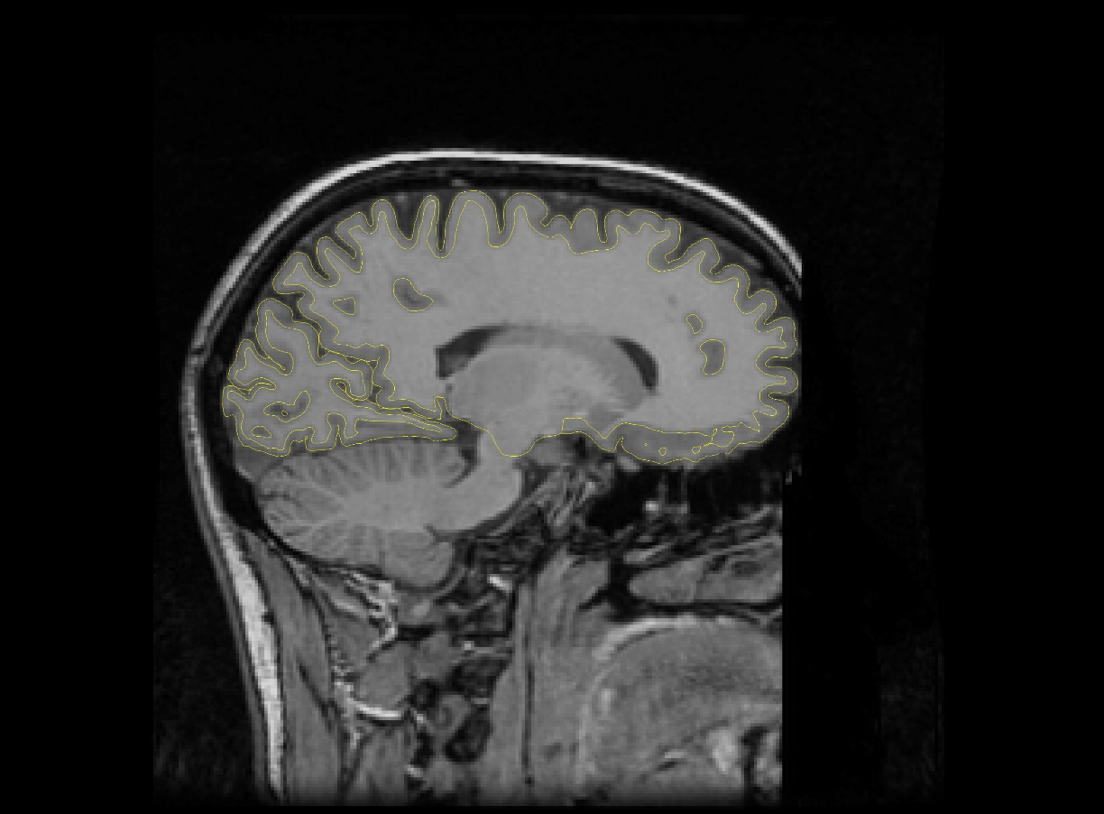
Notes:
To see the ocular dominance columns better we use the model of the cortical surface, computationally inflate it and then overlay the functional activations

Slide 13
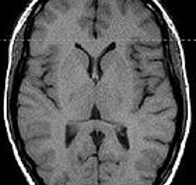
Group 1: morphometry with FreeSurfer
Have
To do
T1w 1mm³ MRI scan
Preprocessing done by FreeSurfer internally
Estimate cortical thickness and volume of subcortical structures (including thalamic nuclei segmentation), plus other parameters FreeSurfer gives out
Group analysis (depending on research question)

Slide 14
Myelin mapping

Slide 15
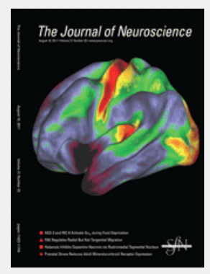
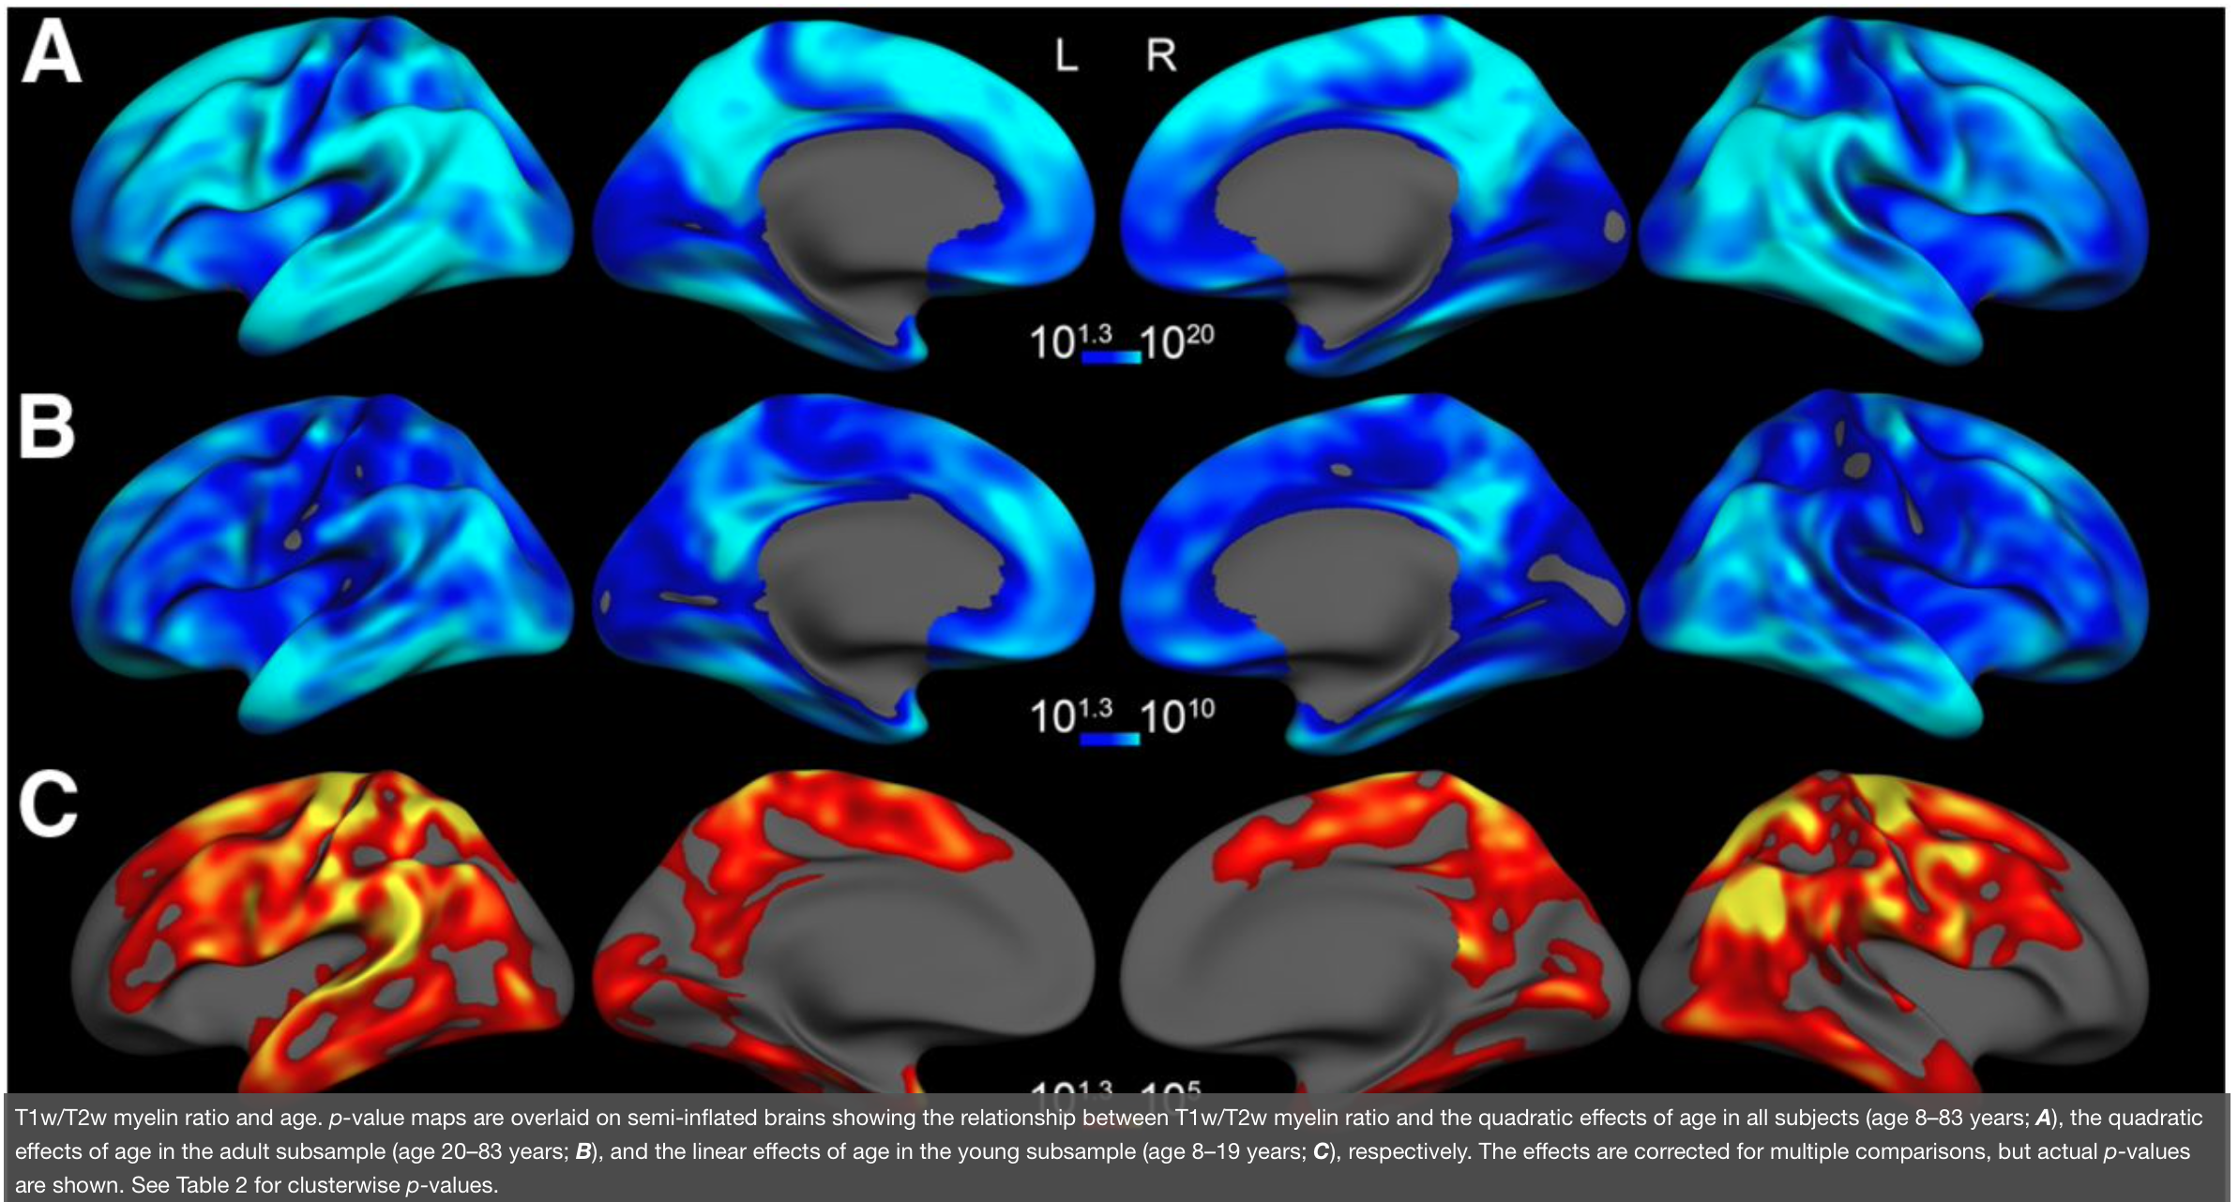
Intracortical myelin
Glasser et al., 2011
Why should we care?
Relationship with e.g. age
https://doi.org/10.1523/JNEUROSCI.2180-11.2011

Slide 16
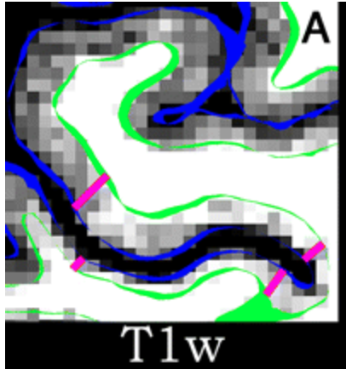
Group 2: Myelin quantification
Have
To do
FreeSurfer recon-all output (including cortical surface reconstruction)
Preprocessing:
registration of T2w-MRI to FreeSurfer space
Divide T1w by T2w to get myelin weighting
Project myelin maps onto the template cortical surface (fsaverage) for whole-brain analysis
Group-level analysis (depending on research question)

